Slide 1

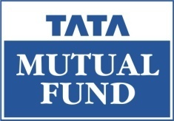
FED TAPERING
OUTRIGHT MONETARY TRANSACTION

Slide 2

Understanding Outright Monetary Transaction

Slide 3

OUTRIGHT MONETARY TRANSACTION
On 6th September, the ECB announced that it will buy unlimited amounts of sovereign debt from troubled countries of the euro zone, subject to certain conditions. The ECB has named this “Outright Monetary Transaction” or OMT.
When we say that the ECB will buy debt, it means that the ECB will buy government bonds of troubled economies of the euro zone.

Slide 4
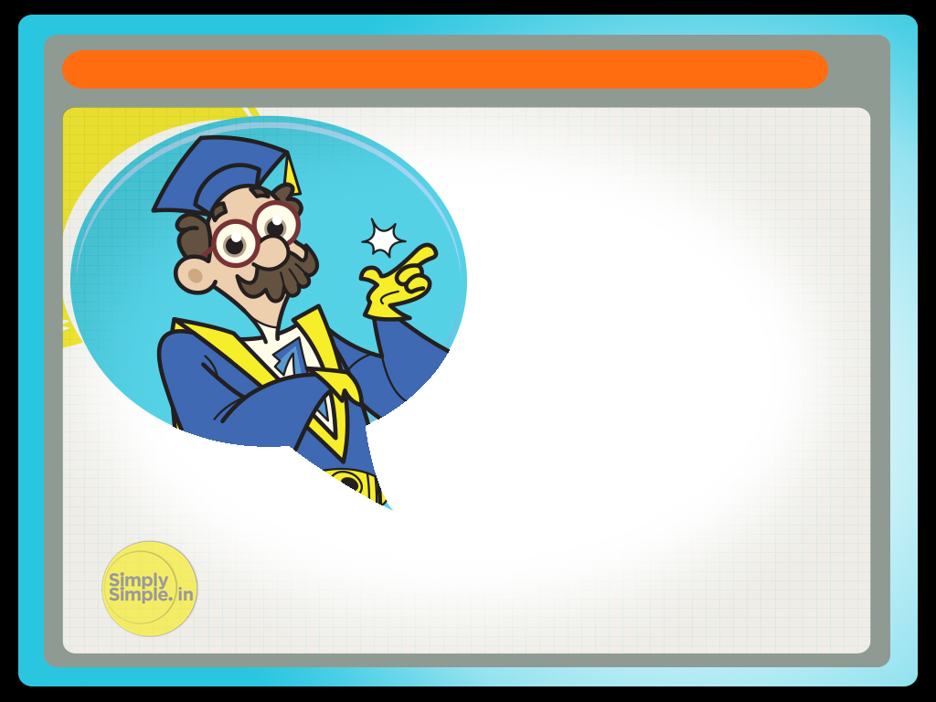
OUTRIGHT MONETARY TRANSACTION
What this means that countries with troubled economies will get the much needed liquidity. However, simply by infusing liquidity, would the troubled economies see their pain evaporate? Is it enough to inject liquidity or is there something else that is the need of the hour?

Slide 5
OUTRIGHT MONETARY TRANSACTION
To get a better insight into this problem, let's look at the following example:-
Let's say Sunil is a brilliant lad. He is 20 years old and goes to a one of the most prestigious colleges of the city. His father is the CEO of a company and he lives in one of the best locations in the city.

Slide 6
OUTRIGHT MONETARY TRANSACTION
Everything seems to be on track for Sunil except for one problem. Sunil suffers from obesity. His weight weighs him down and prevents him to attain the potential that he deserves.
There is a constant tussle between his health and weight and of late, his health has been on the receiving end. Sunil has been suffering from intense back pain.

Slide 7
OUTRIGHT MONETARY TRANSACTION
The doctor prescribes pain killers which gives Sunil immediate relief.
So Sunil continues to live life and does little to cut down his weight. As a result of his lackadaisical ways, the back pain returns with increased intensity. This time when he visits his doctor, he is advised bed rest along with pain killers.

Slide 8
OUTRIGHT MONETARY TRANSACTION
Moreover, the doctor tells him that the bed-rest and pain killers is necessary for getting relief but it not sufficient enough to cure him of the problem. For a sustained solution, he should follow a disciplined exercise and diet regime.

Slide 9

OUTRIGHT MONETARY TRANSACTION
Now let us revisit the OMT relief for the troubled economies and establish the connection. What would be taken as the pain killer and what would construe to be the discipline exercise and diet regime?

Slide 10
OUTRIGHT MONETARY TRANSACTION
A closer analysis would reveal that the OMT can be interpreted to be the “Pain-killers” while structural economic reforms and austerity measures would be taken to mean the disciplined regime.
So just as in the case of Sunil, these economies will certainly get some respite due to this sudden injection of liquidity.

Slide 11
OUTRIGHT MONETARY TRANSACTION
But if they do not embark upon the disciplined course of reforms and take some measures to bring in a culture of voluntary austerity, the problems that these countries have got entangled with may not get solved.

Slide 12
OUTRIGHT MONETARY TRANSACTION
Moreover, this infusion of liquidity, will give the troubled economies immediate relief by ensuring that their borrowing costs don't spiral beyond control. But one should bear in mind that higher liquidity could see money getting diverted towards commodities, putting upward pressure on their prices.

Slide 13
OUTRIGHT MONETARY TRANSACTION
In India, the liquidity could translate into euphoria in the stock market, for which the markets rallied by 2% after the announcement.
But at the same time, if commodity prices continue to increase it could put adverse pressure on the fiscal deficit as well as cause the rupee to weaken due to crude purchase at higher prices.

Slide 14
OUTRIGHT MONETARY TRANSACTION
Hope this lesson has helped you in understanding the term Outright Monetary Transaction

Slide 15

Please give us your feedback at
professor@tataamc.com

Slide 16

DISCLAIMER
The views expressed in this lesson are for information purposes only and do not construe to be any investment, legal or taxation advice. The lesson is a conceptual representation and may not include several nuances that are associated and vital. The purpose of this lesson is to clarify the basics of the concept so that readers at large can relate and thereby take more interest in the product / concept. In a nutshell, Professor Simply Simple lessons should be seen from the perspective of it being a primer on financial concepts. The contents are topical in nature and held true at the time of creation of the lesson. This is not indicative of future market trends, nor is Tata Asset Management Ltd. attempting to predict the same. Reprinting any part of this material will be at your own risk. Tata Asset Management Ltd. will not be liable for the consequences of such action.
Mutual Fund investments are subject to market risks, read all scheme related documents carefully.

